Slide 1


NFT based Move to Earn App
Pound
Pound
Fitness App
CS6611-CREATIVE AND INNOVATIVE PROJECT

Slide 2
MOTIVATION
The motivation behind this project is to make exercising more fun and rewarding for people.
By using a special kind of digital token called NFTs, we can give users rewards for working out and reaching their fitness goals.
It's like turning exercise into a game where you earn points and prizes for staying active.
This not only helps motivate people to exercise more but also creates a sense of accomplishment and excitement around fitness.

Slide 3
01
Problem Statement

Slide 4
Problem statement
Existing fitness apps often fail to effectively motivate users and sustain engagement over time, leading to high dropout rates.
Market saturation and privacy concerns further compound the challenge of attracting and retaining users.
This project aims to address these issues by leveraging NFTs and blockchain technology to create a unique fitness app that incentivizes and rewards users for their achievements, while ensuring data security and regulatory compliance.

Slide 5
02
Literature Survey

Slide 6
Literature Survey
SNO | TITLE | AUTHOR | YEAR | METHOD | ADVANTAGE | SETBACK | SOLUTION
1. | A smartwatch-based framework for real- time and online assessment and mobility monitoring | Sio Jurnalis Pipin Ronsen Purba Muhammad Fermi Pasha | 2018 | ROAMM for real-time and online assessment and mobility monitoring | Leveraging smartwatch technology for data collection and monitoring | Potential limitations in accuracy or reliability | Enhancing data quality and system reliability.
2. | Collection and Processing of Data from Wrist Wearable Devices in Heterogeneous and Multiple-User Scenarios | Francisco de Arriba-Pérez, Manuel Caeiro- Rodríguez | 2022 | Analyzing data collection from wearable devices, identifying interoperability challenges, proposing guidelines, and situating the work | Comprehensive approach to integrating various systems (wearables, smartphones, computers, and servers/cloud services) for smartwatch data collection | Limited progress in developing smartwatch apps for activity data collection | Investing in user- friendly smartwatch data collection apps and fostering collaborations can mitigate the setback of limited progress in this domain

Slide 7
Literature Survey
SNO | TITLE | AUTHOR | YEAR | METHOD | ADVANTAGE | SETBACK | SOLUTION
3. | MedAi: A Smartwatch-Based Application Framework for the Prediction of Common Diseases Using Machine Learning | Shinthi Tasnim Himi, Natasha Tanzila, Monalisa, MD Whaiduzzaman, Alistair Barros, Mohammad shorif uddin | 2023 | multi-sensor smartwatch prototype called "Sense O'Clock" along with machine learning algorithms | Enabling comprehensive disease prediction | Lack of comprehensiv e solutions integrating wearable technology | Correct application of wearable devices can increase accuracy
4. | MiLift: Efficient Smartwatch-based Workout Tracking Using Automatic Segmentation | Chenguang Shen, Bo-Jhang Ho, Mani Srivastava | arXiv: 2022 | Lightweight repetition detection algorithms | Eliminating the need for manual inputs | Reliance on commercial off-the-shelf smartwatches | Allowing users to customize tracking frequency

Slide 8
Literature Survey
SNO | TITLE | AUTHOR | YEAR | METHOD | ADVANTAGE | SETBACK | SOLUTION
5. | Watch Your Smartwatch | Sharrah, Ayed Salman, Imtiaz Ahmad | 2018 | Traditional forensic techniques such as logical acquisition, file system analysis | Addressing physical, backup | Lack of consideration for the security and privacy implications | Robust security measures such as user authentication
6. | Using Data from Wearables for Better Sleep | Juan F. Arias | 2022 | Comprehensive activity and sleep data aggregation, facilitating correlation analysis on sleep quality. | Gather real-time information on nutrition, activity, and sleep patterns | Data inaccuracies or inconsistencies due to limitations in wearable device sensors or self-reported nutrition data | Real time collection of wearable data and processing it for better representation of sleep data.

Slide 9
Literature Survey
SNO | TITLE | AUTHOR | YEAR | METHOD | ADVANTAGE | SETBACK | SOLUTION
7. | NFTs: Applications and Challenges | Wajiha Rehman; Hijab e Zainab; Jaweria Imran | 2019 | NFT Club - An attempt to generalize a concept that is pretty known to the public but needs to be understood clearly. | Addressing physical, backup | Lack of consideration for the security and privacy implications | Robust security measures such as user authentication
8. | NFT Club – A NFT Marketplace | R J Anandhi; Ankurit Bhakta; Aditya Purswani; Karan Karan; Aditya Mishra | 2020 | Comprehensive activity and sleep data aggregation, facilitating correlation analysis on sleep quality. | Gather real-time information on nutrition, activity, and sleep patterns | Data inaccuracies or inconsistencies due to limitations in wearable device sensors or self-reported nutrition data | Real time collection of wearable data and processing it for better representation of sleep data.

Slide 10
Literature Survey
SNO | TITLE | AUTHOR | YEAR | METHOD | ADVANTAGE | SETBACK | SOLUTION
9. | Watch Your Smartwatch | Sharrah, Ayed Salman, Imtiaz Ahmad | 2018 | Traditional forensic techniques such as logical acquisition, file system analysis | Addressing physical, backup | Lack of consideration for the security and privacy implications | Robust security measures such as user authentication
10. | Using Data from Wearables for Better Sleep | Juan F. Arias | 2022 | Comprehensive activity and sleep data aggregation, facilitating correlation analysis on sleep quality. | Gather real-time information on nutrition, activity, and sleep patterns | Data inaccuracies or inconsistencies due to limitations in wearable device sensors or self-reported nutrition data | Real time collection of wearable data and processing it for better representation of sleep data.

Slide 11
03
Gaps Identified

Slide 12
Gaps Identifed
Long-Term Engagement and Motivation
Community Support and Accountability
Monetization Opportunities for Fitness Professionals
Many fitness apps struggle to maintain user engagement beyond the initial excitement or commitment phase.
By gamification and integrating NFTs as rewards for achieving fitness milestones, your app can provide users with tangible, collectible tokens that signify their accomplishments.
Some fitness apps offer social features like sharing workouts or connecting with friends, there's often a lack of meaningful community engagement and support.
Your app could establish a vibrant community where users can participate in challenges, share their progress, and support each other's fitness journeys
Users engage in fitness games to win levels and achieve targets.
These make them win NFTs and becomes an oppurtunity for them to mint and trade NFTs.

Slide 13
04
Diagrams

Slide 14
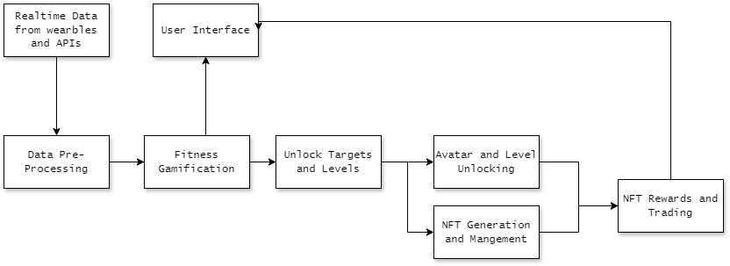
Block Diagram

Slide 15
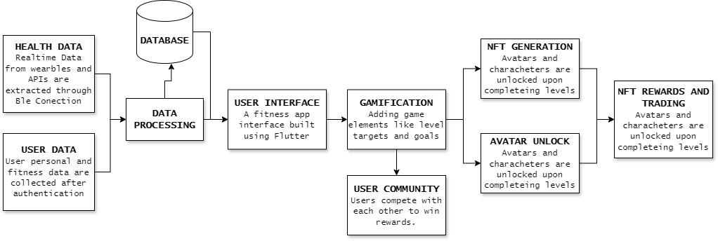
Detailed Diagram

Slide 16
05
Evaluation Metrics

Slide 17
Evaluation Metrics
User Engagement and Retention
NFT Generation and Management
Track Daily and Monthly Active Users, session duration, and retention rate to gauge user interest and loyalty.
Monitor efficiency, speed, and security of NFT creation and storage to maintain integrity and trust in the reward system.
Fitness App
Gamification Effectiveness
Blockchain Integration
Measure user progress, avatar unlocks, and participation rates in challenges to assess the impact of gamified elements on user motivation.
Evaluate transaction speed, costs, and security of blockchain-based transactions to facilitate smooth NFT rewards and trading.
User Satisfaction and Market Performance
Real-time Data Integration
Ensure accuracy, low latency, and reliability of data from wearables and APIs to provide timely feedback on fitness activities.
Gather feedback, ratings, and market share data to understand user satisfaction and app positioning within the fitness and NFT market.

Slide 18
06
Module Wise Test Cases

Slide 19
Authentication
Test Case Id | Input | Pre-Condition | Description | Expected Output | Actual Output
TC _01 | User enters a valid credentials | User has already registered in the website | Login using valid credentials | Login Successful and directs to the homepage | The user gets logged in and get directed to homepage
TC_02 | User enters a wrong password | User has already registered in the website | Login using invalid credentials | Login unsuccessful and error message prompts | The login is unsuccessful and a error message prompts in the screen
TC_03 | User enters a invalid institution code | User has already registered in the website | Login using invalid credentials | Login unsuccessful and error message prompts | The login is unsuccessful and a error message prompts in the screen

Slide 20
Wearable device Integration
Test Case Id | Input | Pre-Condition | Description | Expected Output | Actual Output
TC_01 | User attempts to connect their wearable device to the app. | Wearable device is compatible and available for pairing. | Verify that users can successfully connect their wearable device to the app.. | Wearable device is paired with the app, and fitness data can be synced. | Wearable device is paired with the app, and fitness data can be synced.
TC_02 | User attempts to connect a non-compatible wearable device to the app. | Wearable device is not compatible with the app. | Ensure that users are unable to connect incompatible wearable devices. | User receives an error message indicating that the device is not supported. | User receives an error message indicating that the device is not supported.

Slide 21
Wearble RealTime Data
Test Case Id | Input | Pre-Condition | Description | Expected Output | Actual Output
TC_01 | Service UUID: 00002a37-0000-1000-8000-00805f9b34fb | Wearable is connected via Bluetooth. | Heart Rate measurement from wearable. | Heart rate bpm | Heart rate bpm
TC_02 | Service UUID: FF06 | Wearable is connected via Bluetooth. | Step count measurement from wearable. | Step count | Step count
TC_03 | Service UUID: 00000005-0000-3512-2118-0009af100700 | Wearable is connected via Bluetooth. | Activity data measurement from wearable. | Calories Burned, Workout time | Workout time,calories Burned.

Slide 22
User Achievement
Test Case Id | Input | Pre-Condition | Description | Expected Output | Actual Output
TC_01 | Simulated user reaching a predefined step count goal. | User account exists with a set step count goal. | Verify that when a user achieves a fitness goal (e.g., reaching a certain step count, burning a specific number of calories), the system triggers the NFT generation process. | Verify that the system generates the corresponding NFT and assigns it to the user's wallet. | System generates corresponding NFT .

Slide 23
Avatar Creation
Test Case Id | Input | Pre-Condition | Description | Expected Output | Actual Output
TC_01 | Simulated user advancing to a higher level. | User account exists with a level advancement. | Ensure that when a user attains a new level, the system generates a unique avatar NFT. | The system generates a new avatar NFT reflecting the user's current level and assigns it to the user's wallet. | Avatar NFT generated and assigned to the user's wallet accurately.

Slide 24
Leaderboard and Competition
Test Case Id | Input | Pre-Condition | Description | Expected Output | Actual Output
TC_01 | Simulated competition with user participation and winner determination | Ongoing competition with predefined rules and participants. | Validate that users who top the leaderboard or win a competition receive exclusive NFT rewards. | The system generates unique NFT rewards for competition winners and distributes them to their wallets. | NFT rewards generated and distributed correctly to competition winners.

Slide 25
NFT Generation
Test Case Id | Input | Pre-Condition | Description | Expected Output | Actual Output
TC_01 | NFT transfer from the fitness app to the user's cryptocurrency wallet. | User has an active cryptocurrency wallet linked to the fitness app. | Test the integration between the fitness app and the cryptocurrency wallet for seamless NFT storage and management. | The NFT transfer is executed successfully, and the transferred NFT appears correctly in the user's wallet.. | NFT transfer completed without errors, and the transferred NFT displayed accurately in the user's wallet.

Slide 26
07
Implementation and Screenshots

Slide 27
Pound App Sections
Creature Avatar and NFT Rewards
01
OnBoarding and Authentication
04
Fitness App
02
Health and Fitness Tracking
05
NFT collection and Trade
03
06
Profile and Info
Fitness Targets and community challenges

Slide 28
OnBoarding and Authentication
01
The onboarding process may include tutorial screens highlighting key features of the fitness app.
Tracking workouts, setting meal plans, or accessing instructional exercise videos, to help users get acquainted with the app's functionalities quickly.
Login Screen and Registration Screen are used to authenticate and Invite the user.

Slide 29
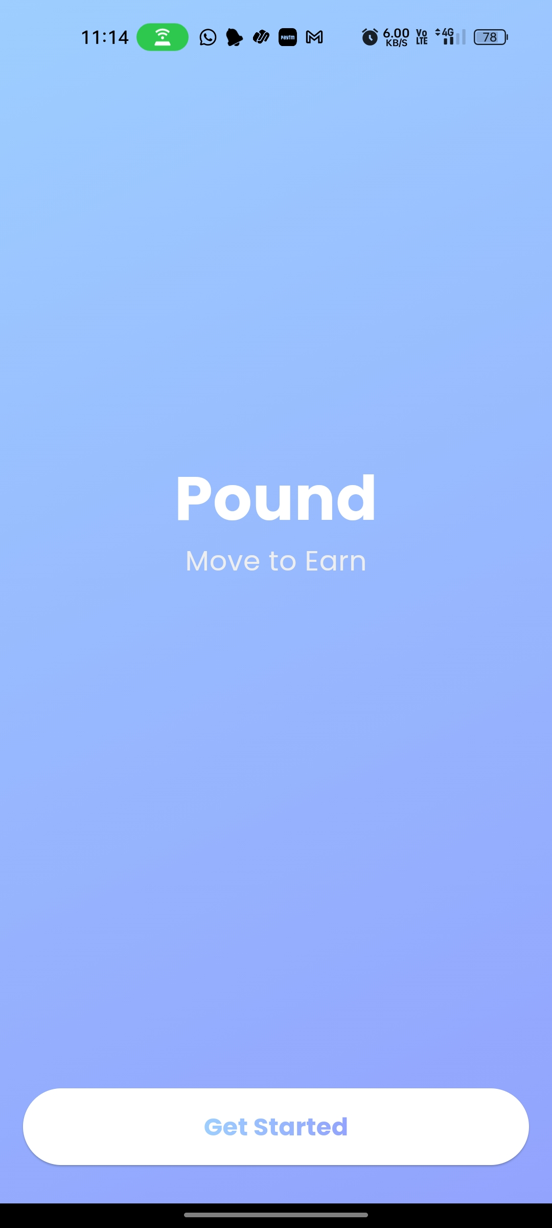
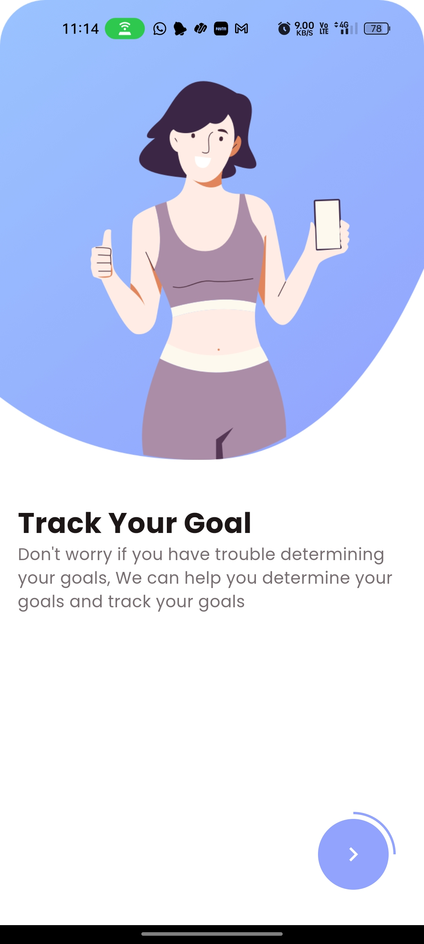
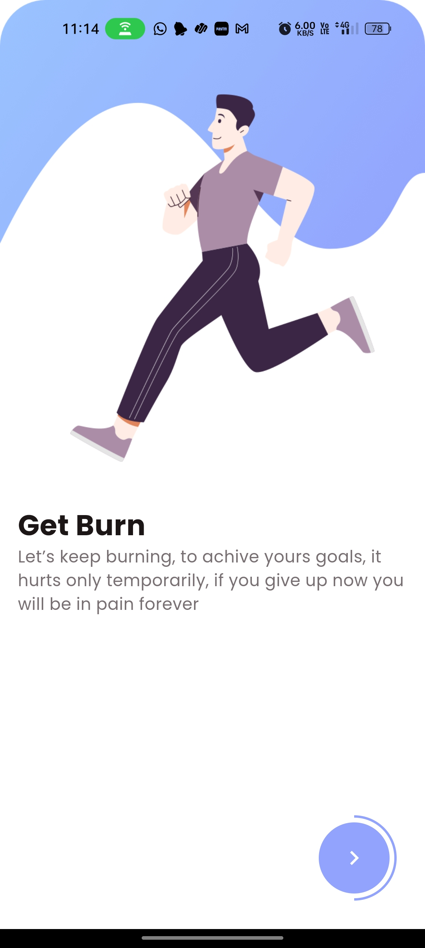

OnBoarding and Authentication
01

Slide 30
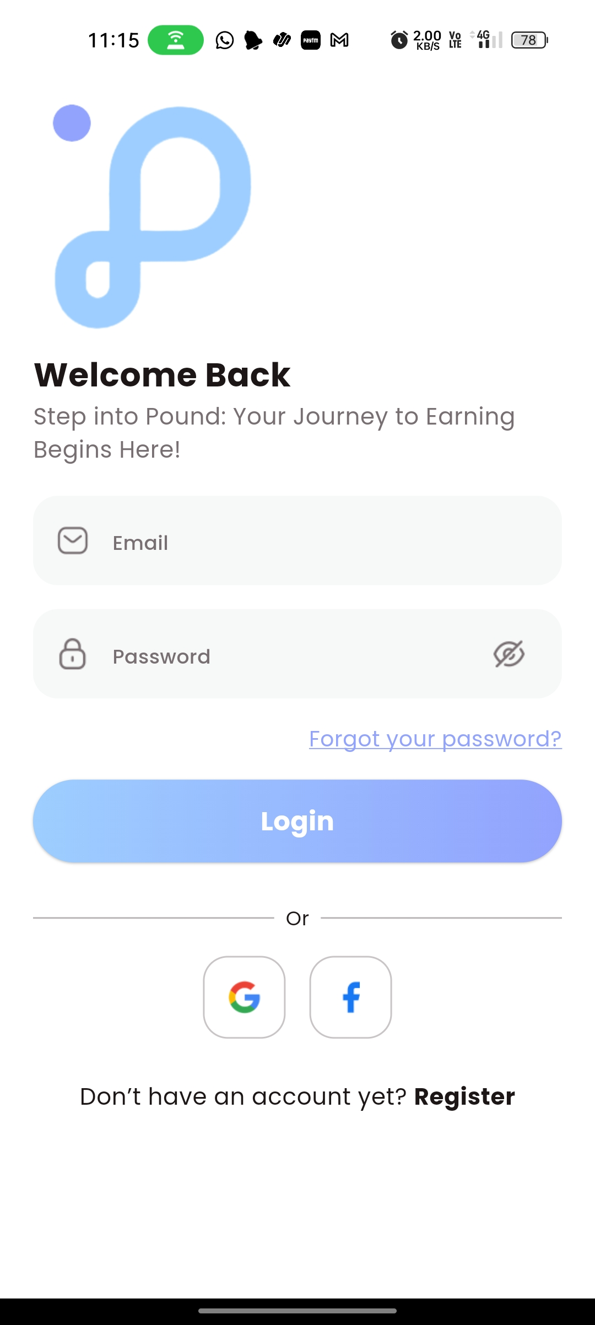
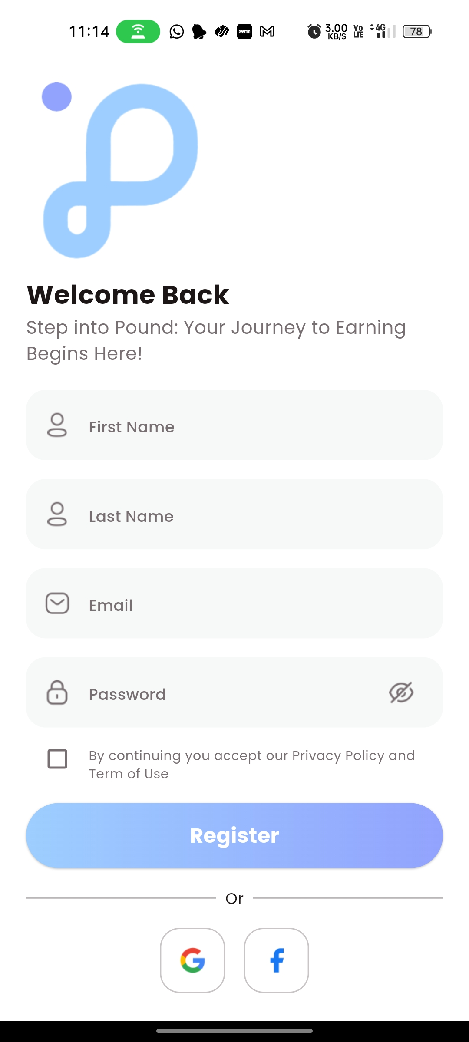
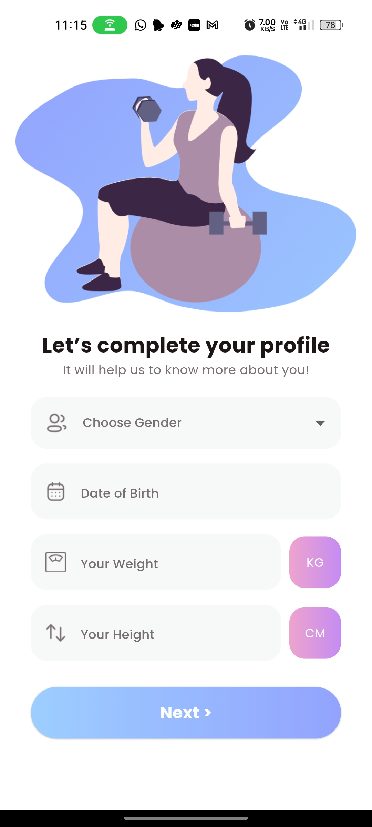
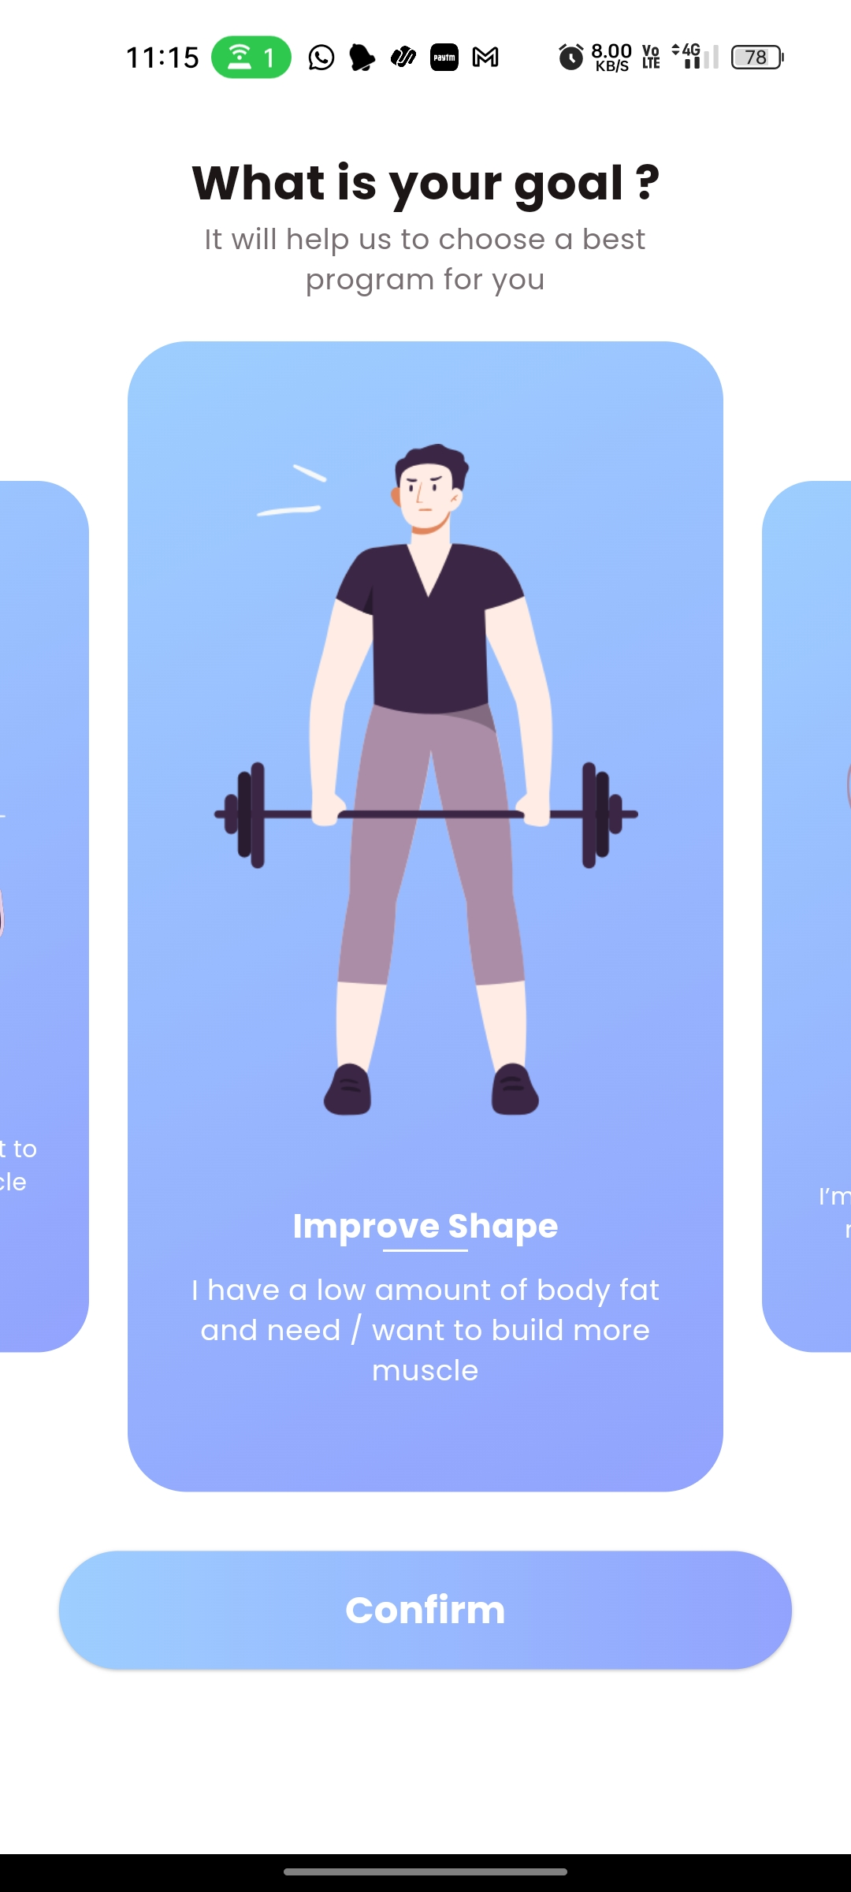
OnBoarding and Authentication
01

Slide 31
Health and Fitness Tracking
02
User Data is collected through APIs and wearables for Heath and Fitness Tracking.
These data are fed to Fitness Trackers to analyze and visualize the fitness data.
example: Sleep Tracker ,Water Intake, Heartrate ,Progress Tracker, Meal planner.

Slide 32
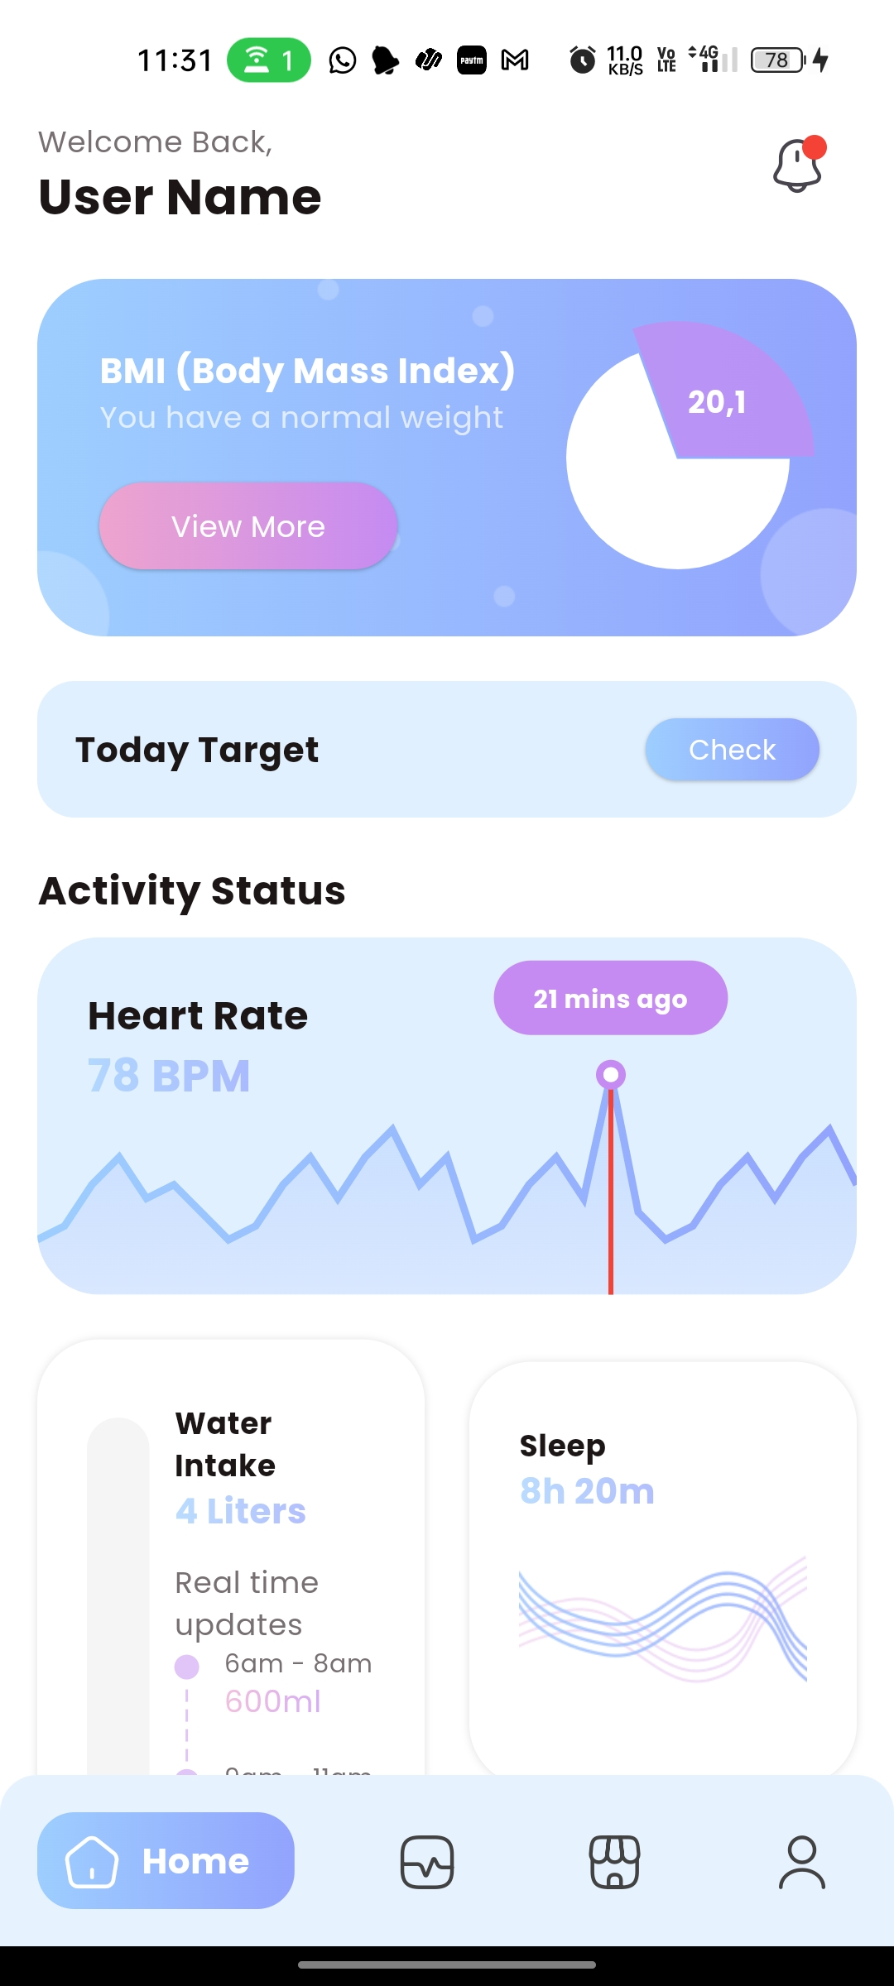
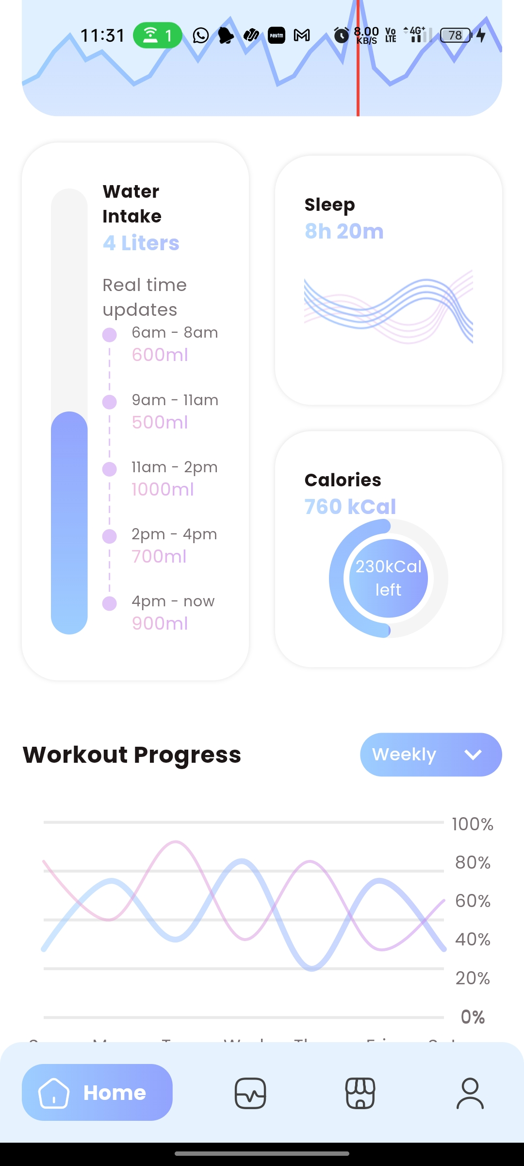
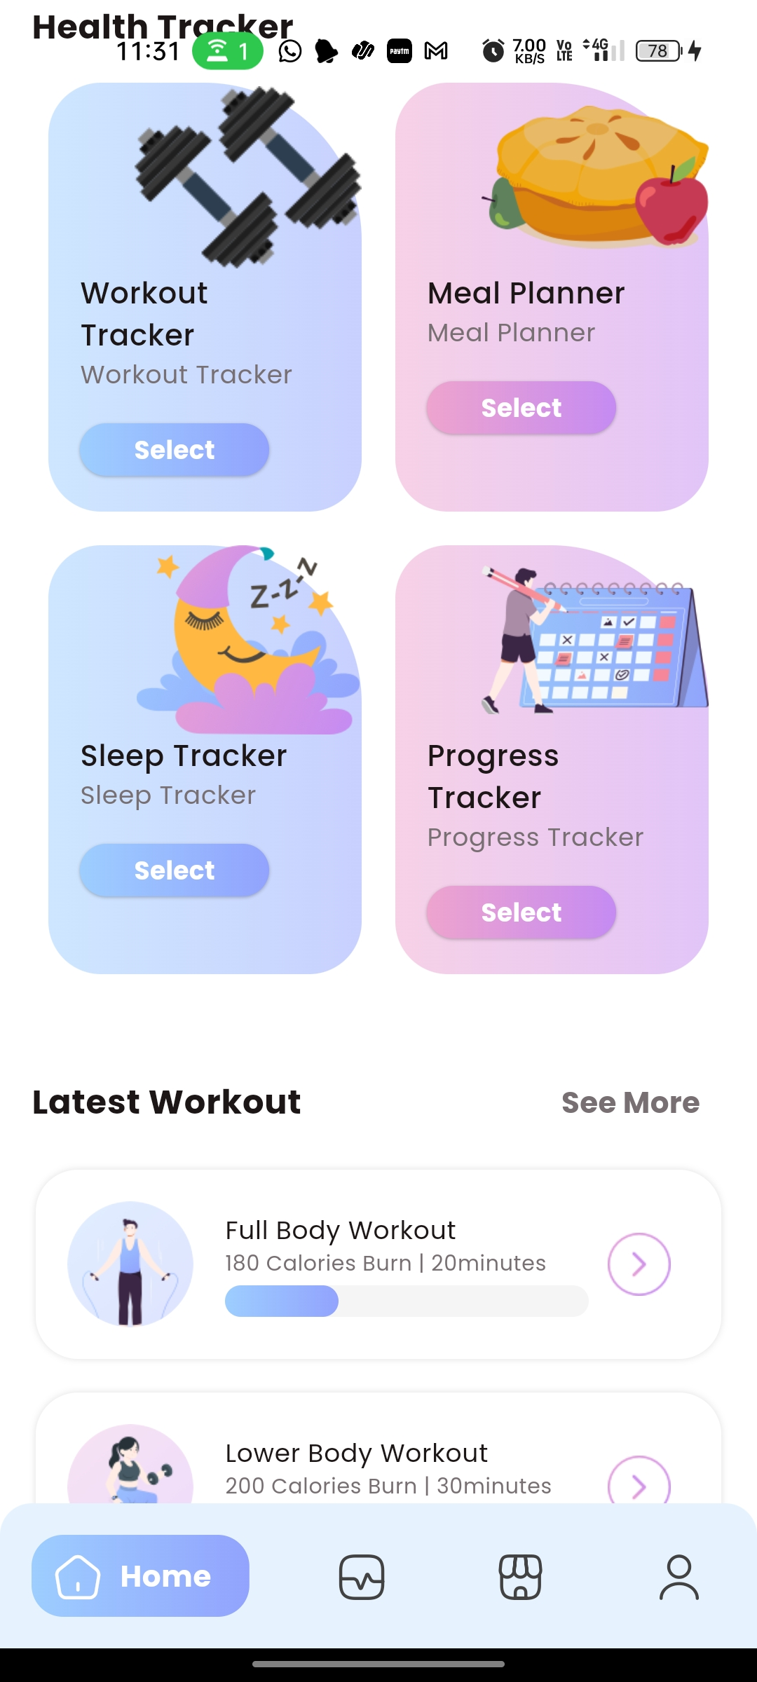
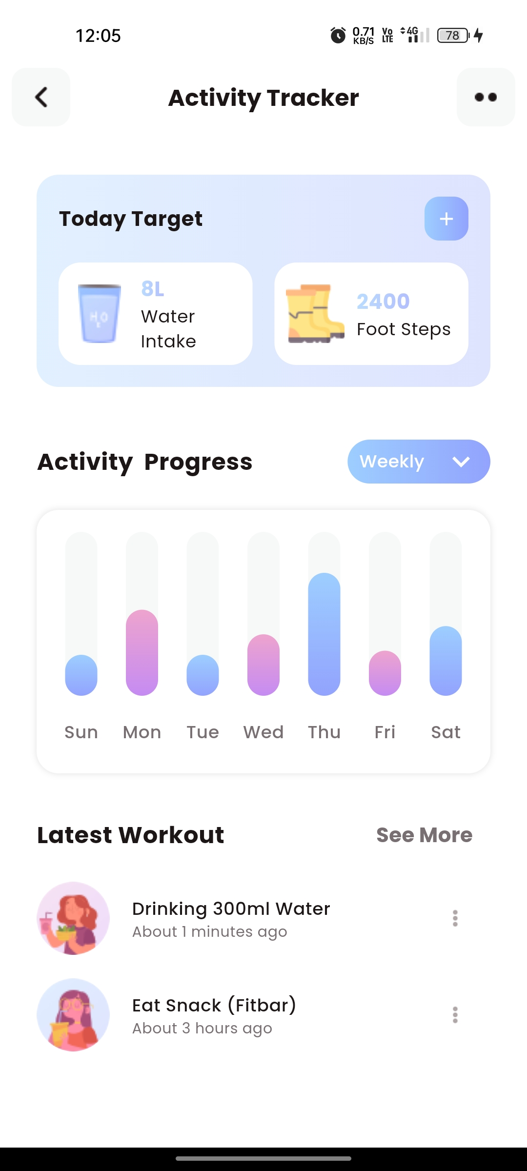
Health and Fitness Tracking
02

Slide 33
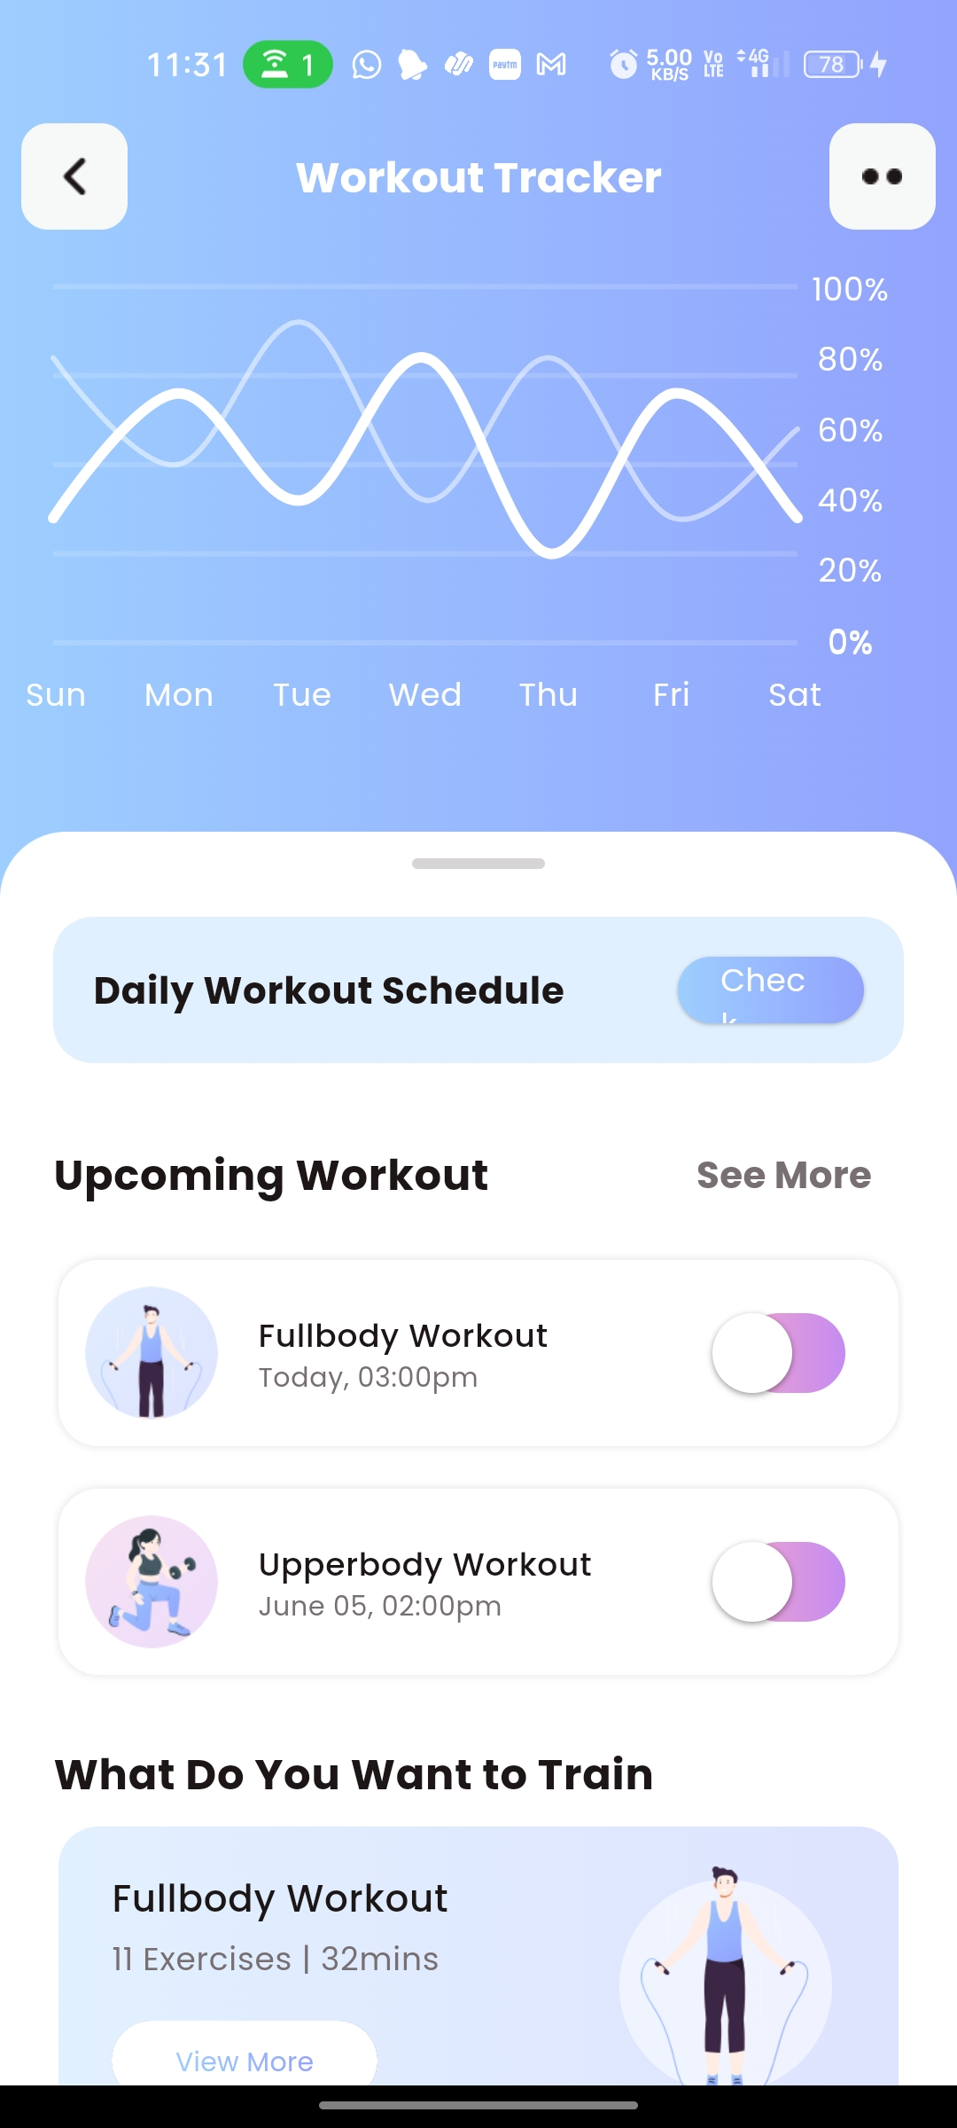
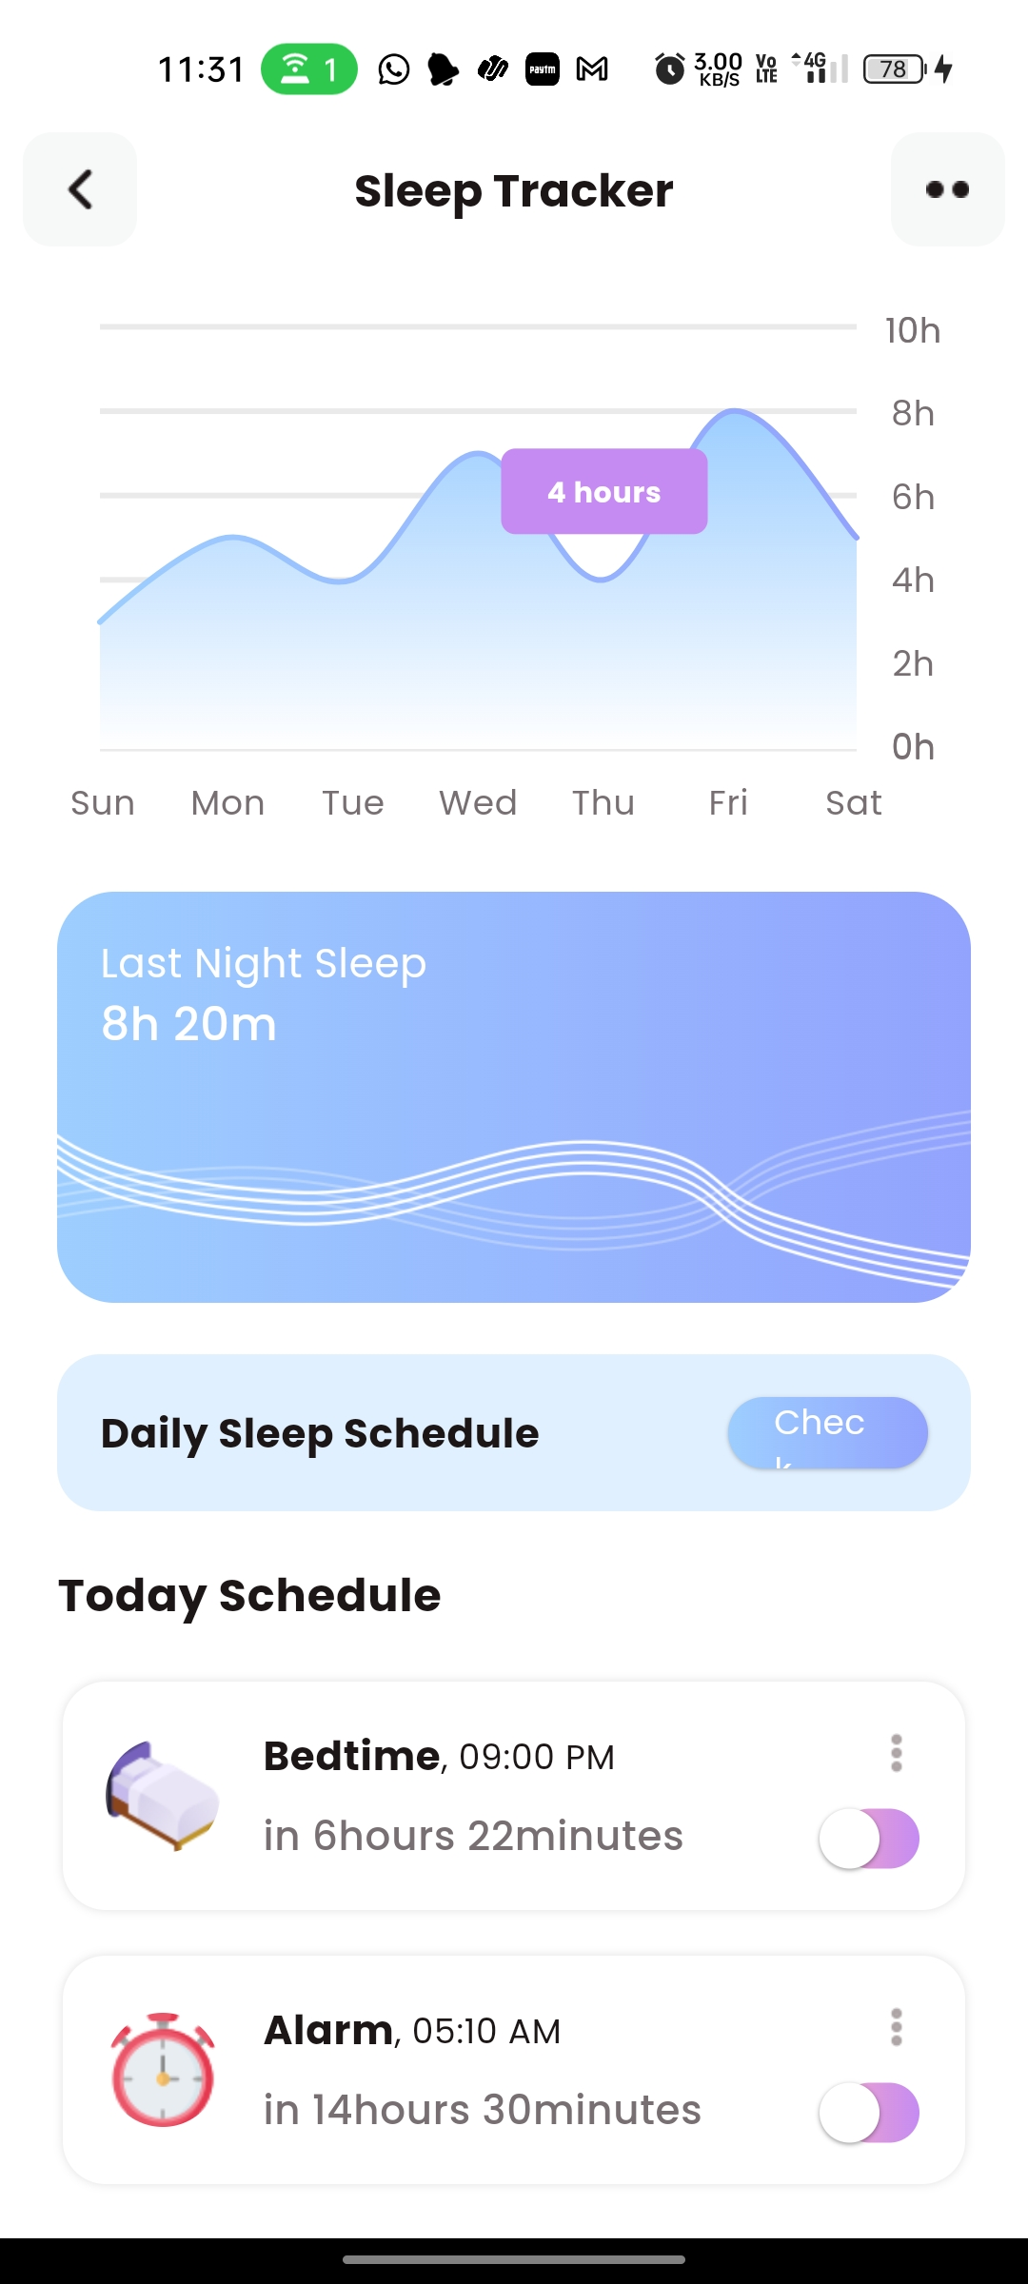
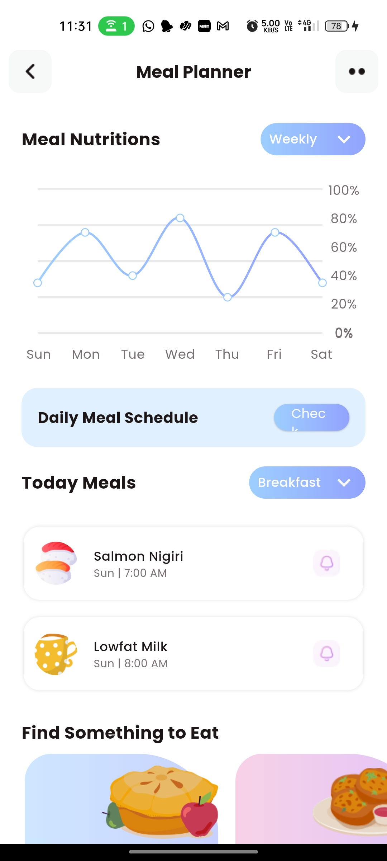
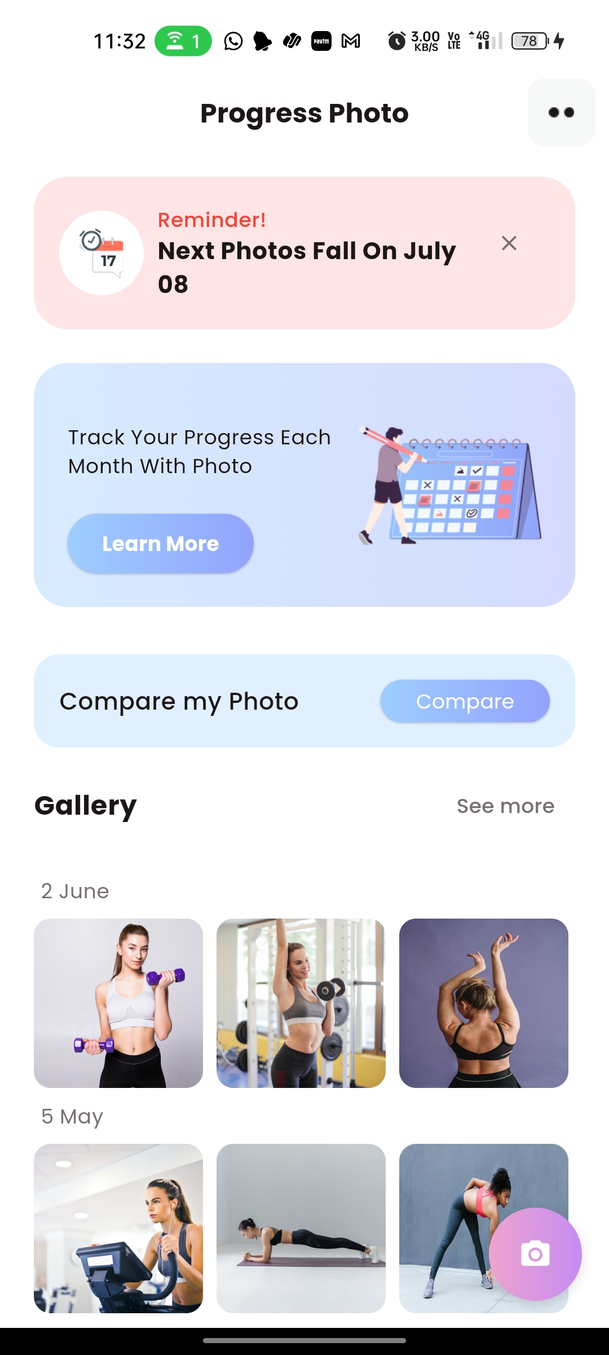
Health and Fitness Tracking
02

Slide 34
Fitness Targets and Community Challenges
03
Fitness Targets are transformed into thrilling challenges, turning workouts into epic battles where users compete and conquer.
Users hustle with each other top the leaderboard and win rarity NFTs.

Slide 35
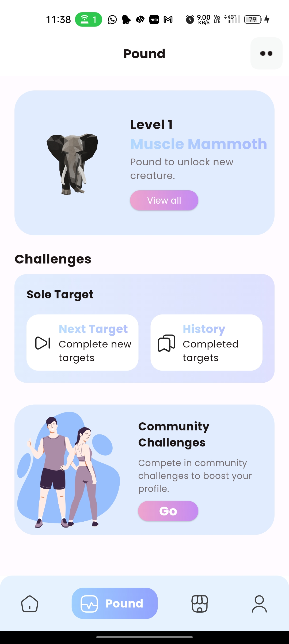
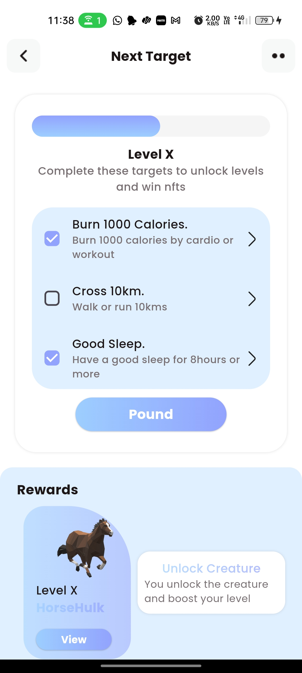
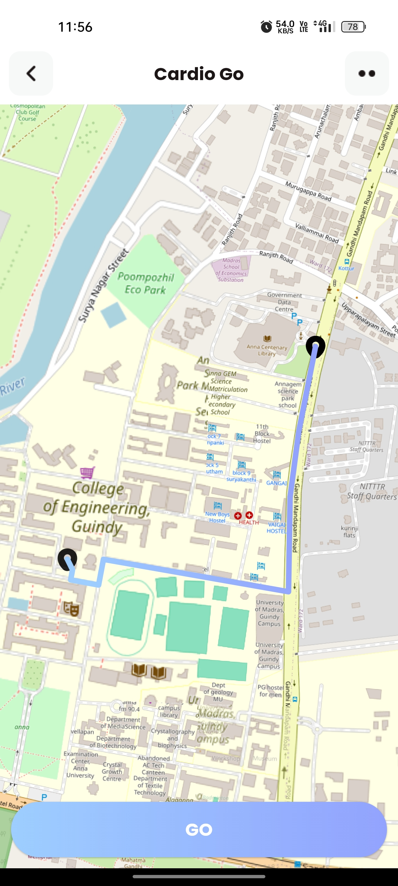
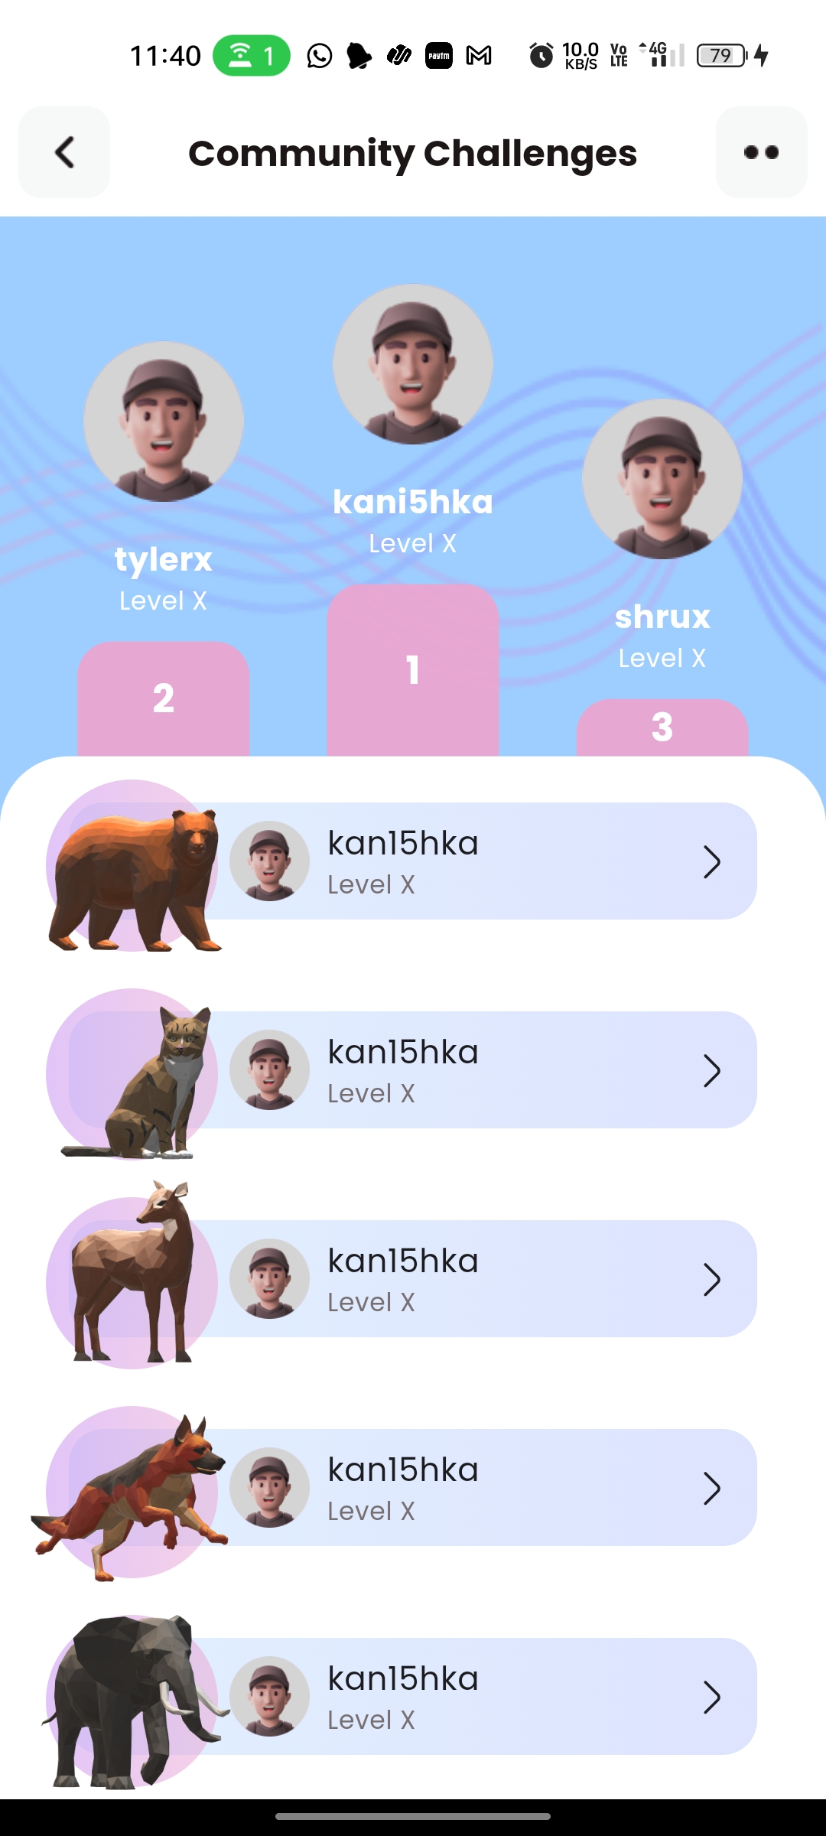
Fitness Targets and Community Challenges
03

Slide 36
Creature Avatar and NFT Rewards
04
Unlock Fictional Creature avatars at each level, adding a magical twist to workouts as mythical allies join the quest for fitness supremacy.
Earn NFTs with every level conquered, turning sweat into digital wealth and making each achievement a valuable token of success.

Slide 37
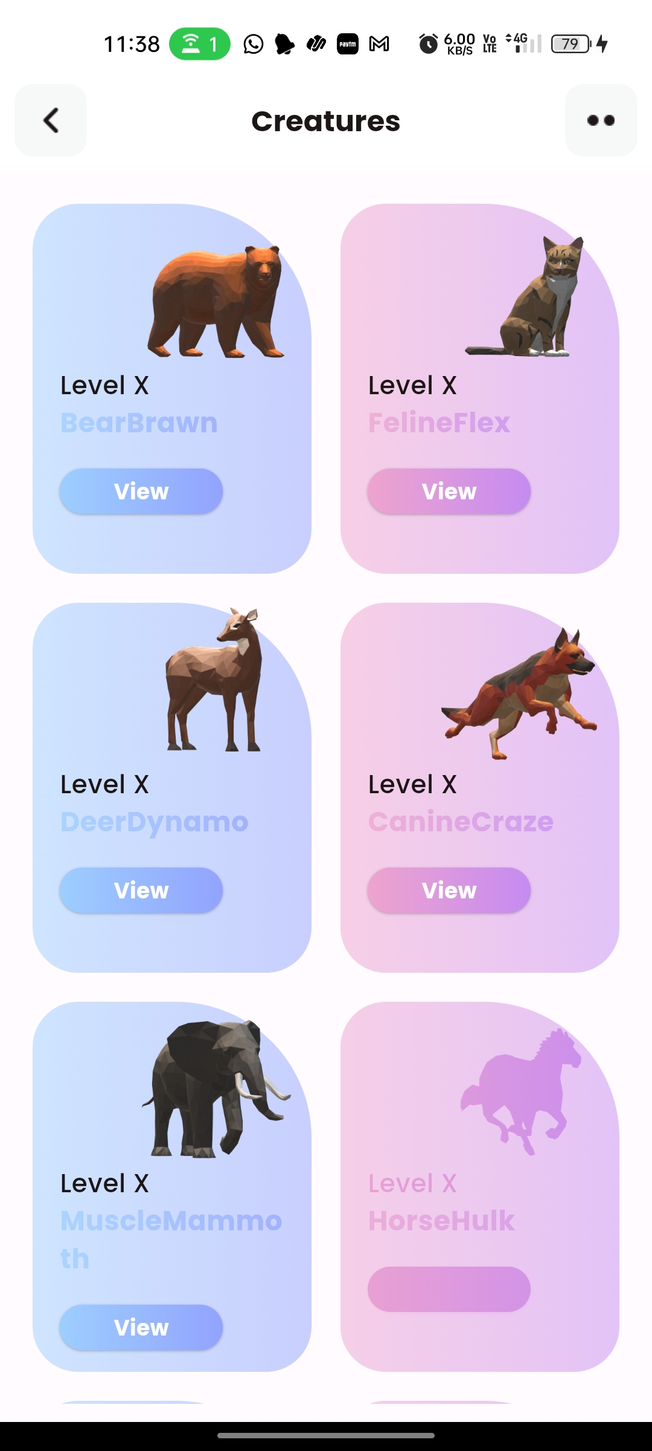
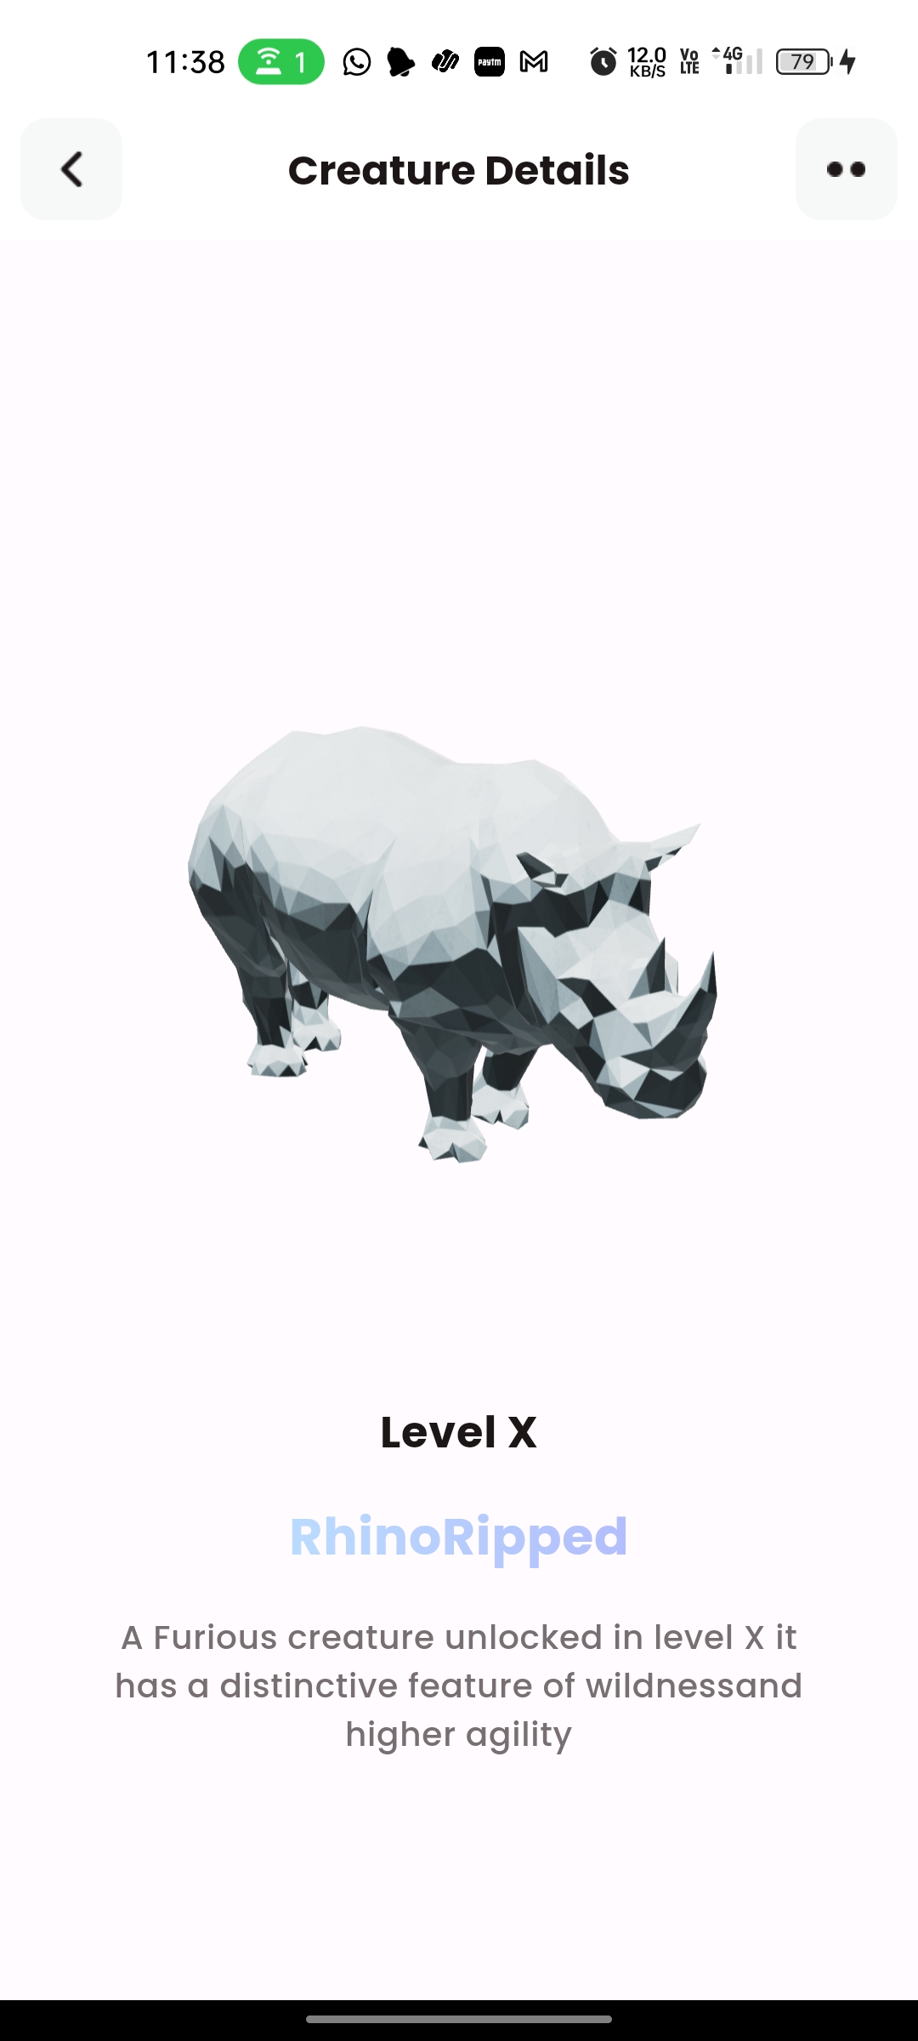
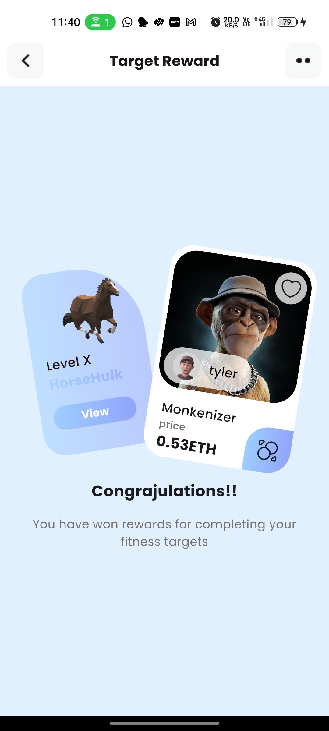
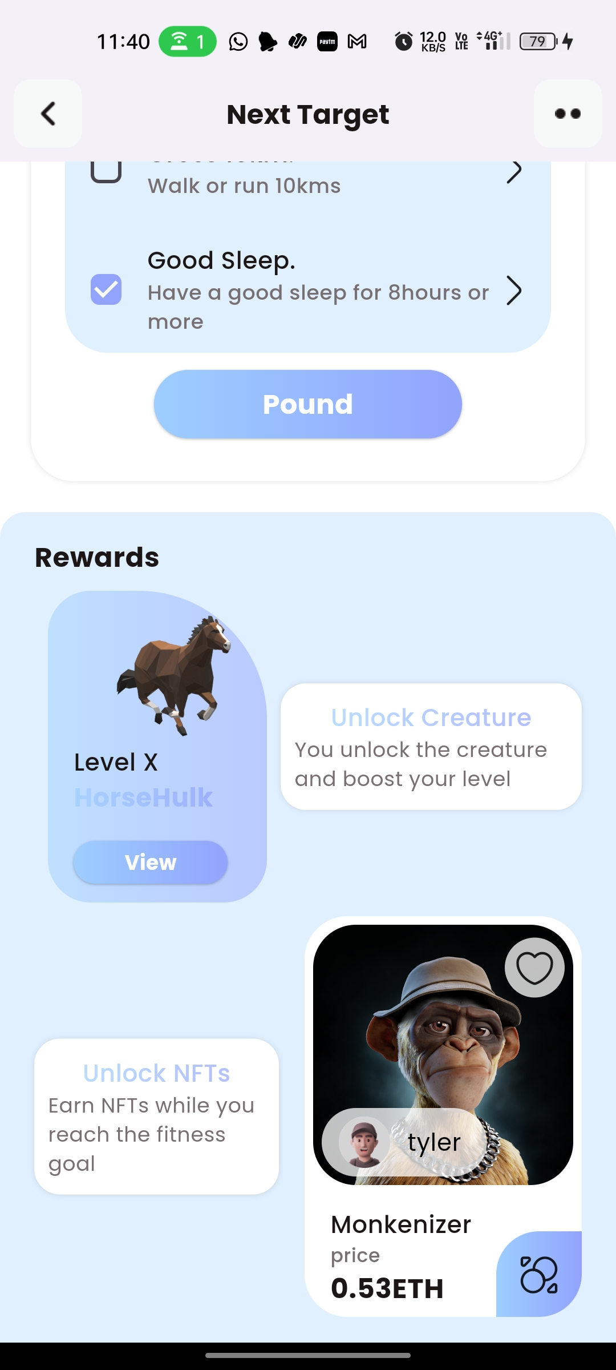
Creature Avatar and NFT Rewards
04

Slide 38
NFT Collection and
Trade
05
The unlocked NFTs are available in the users wallet and they can trade them for money.
The app stands out by combining fitness goals with earning potential, empowering users to achieve personal fitness milestones while also providing them with opportunities to earn..

Slide 39
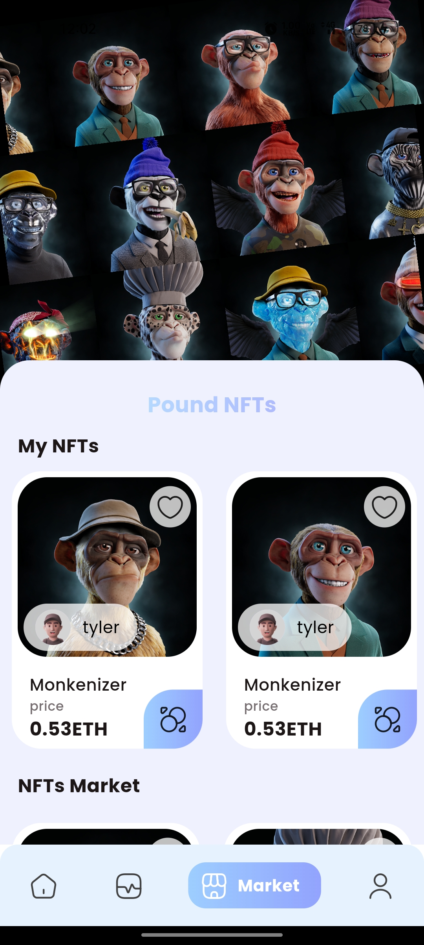
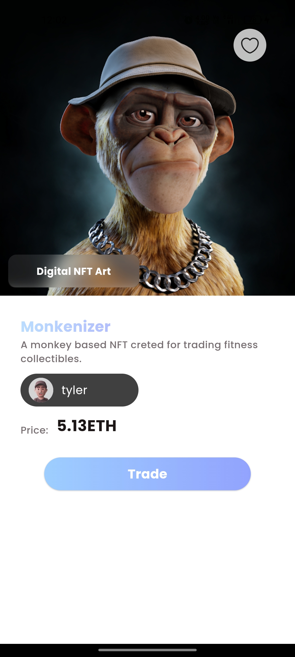
NFT Collection and Trade
05

Slide 40
Profile and
Information
06
Create user profiles with comprehensive fitness data and personalized information, allowing individuals to track their progress, set goals, and access tailored recommendations for optimal results.
Integration with wearable data are also displayed.

Slide 41
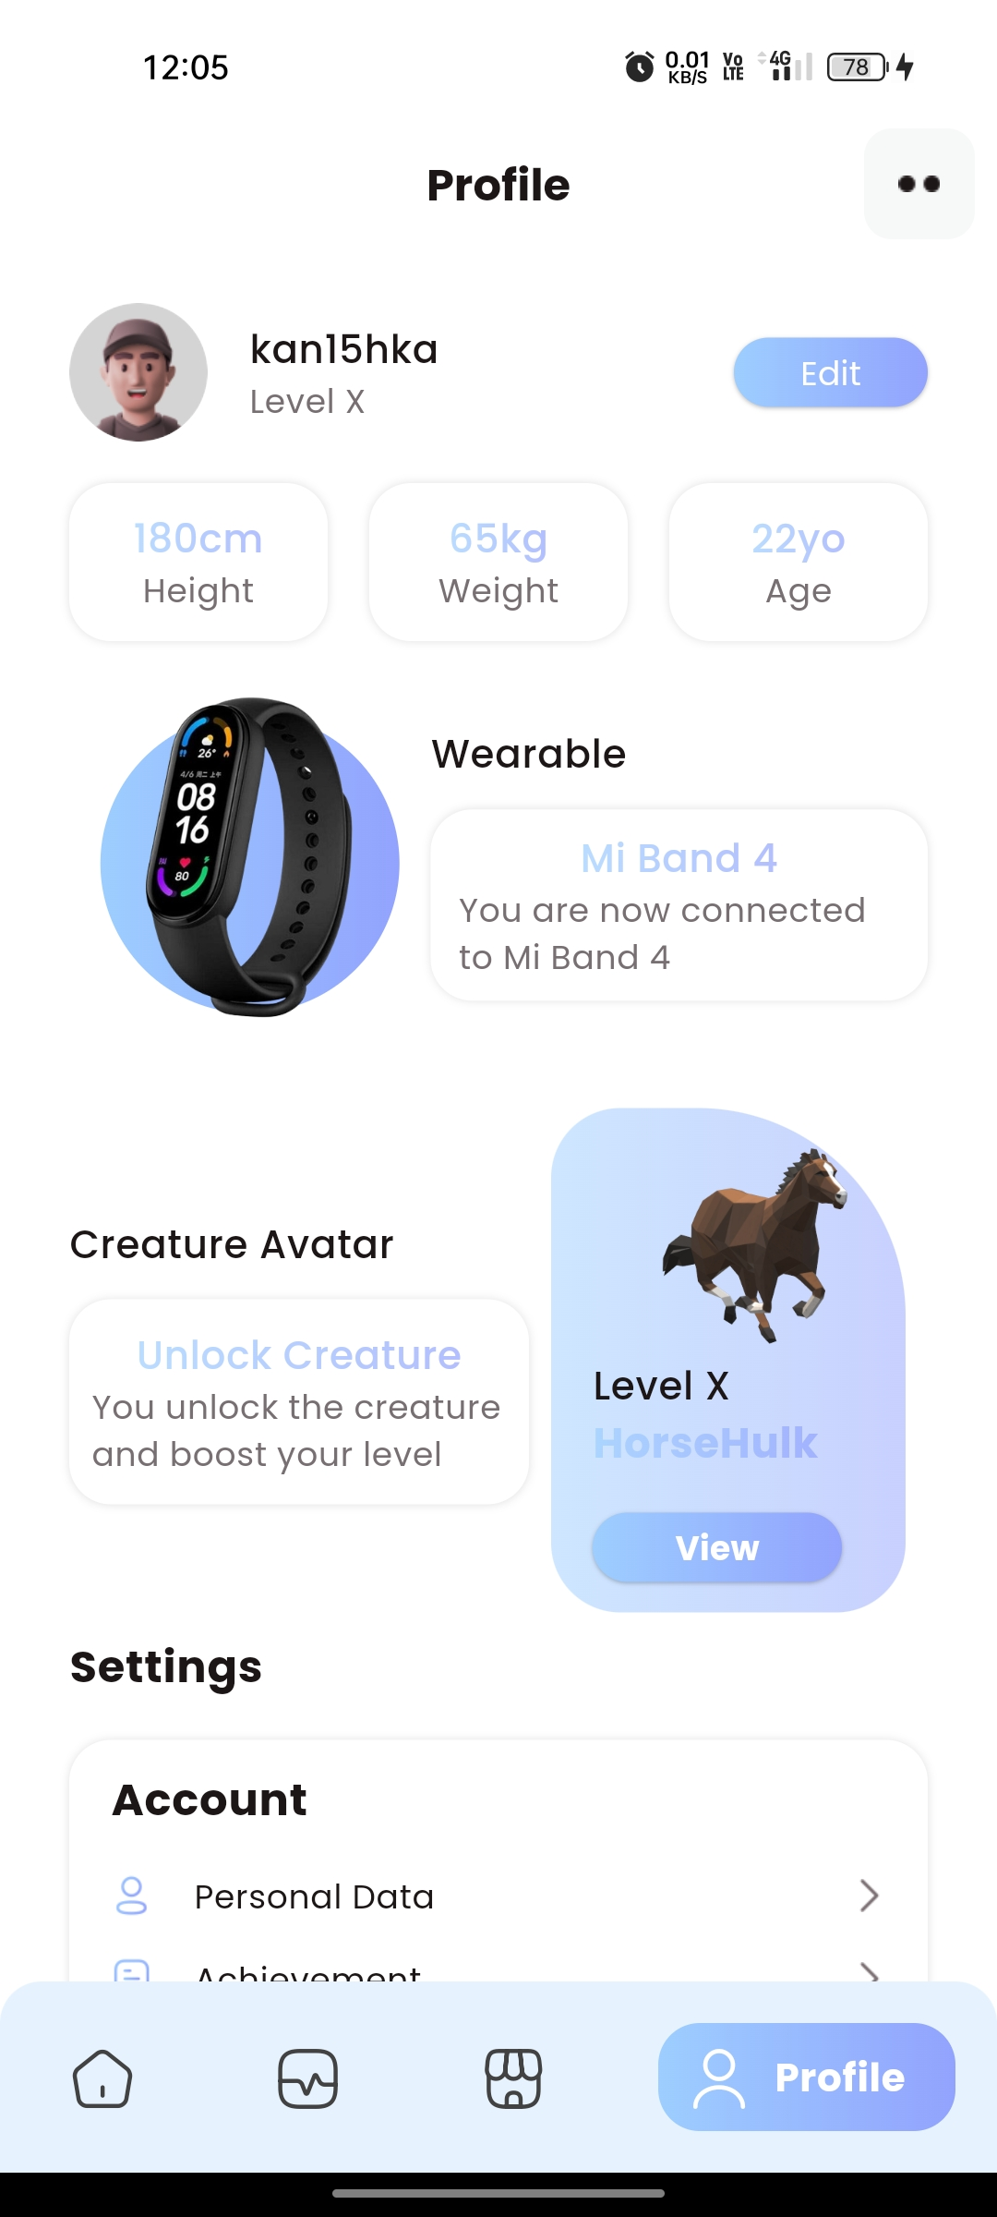
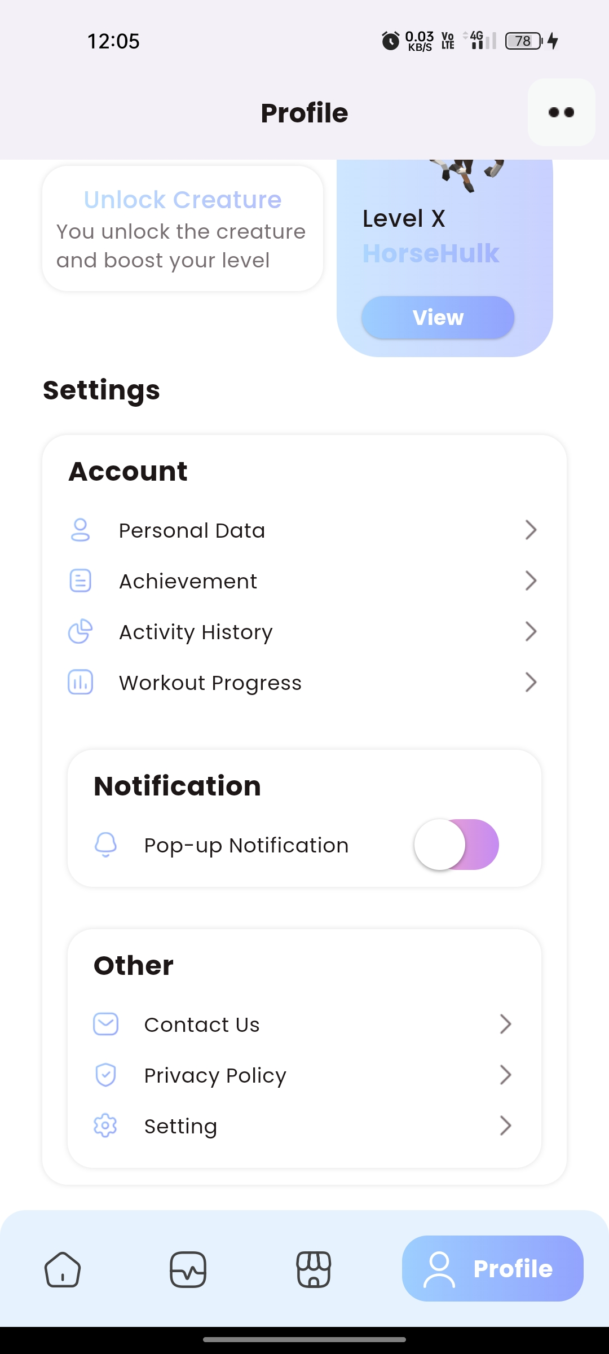
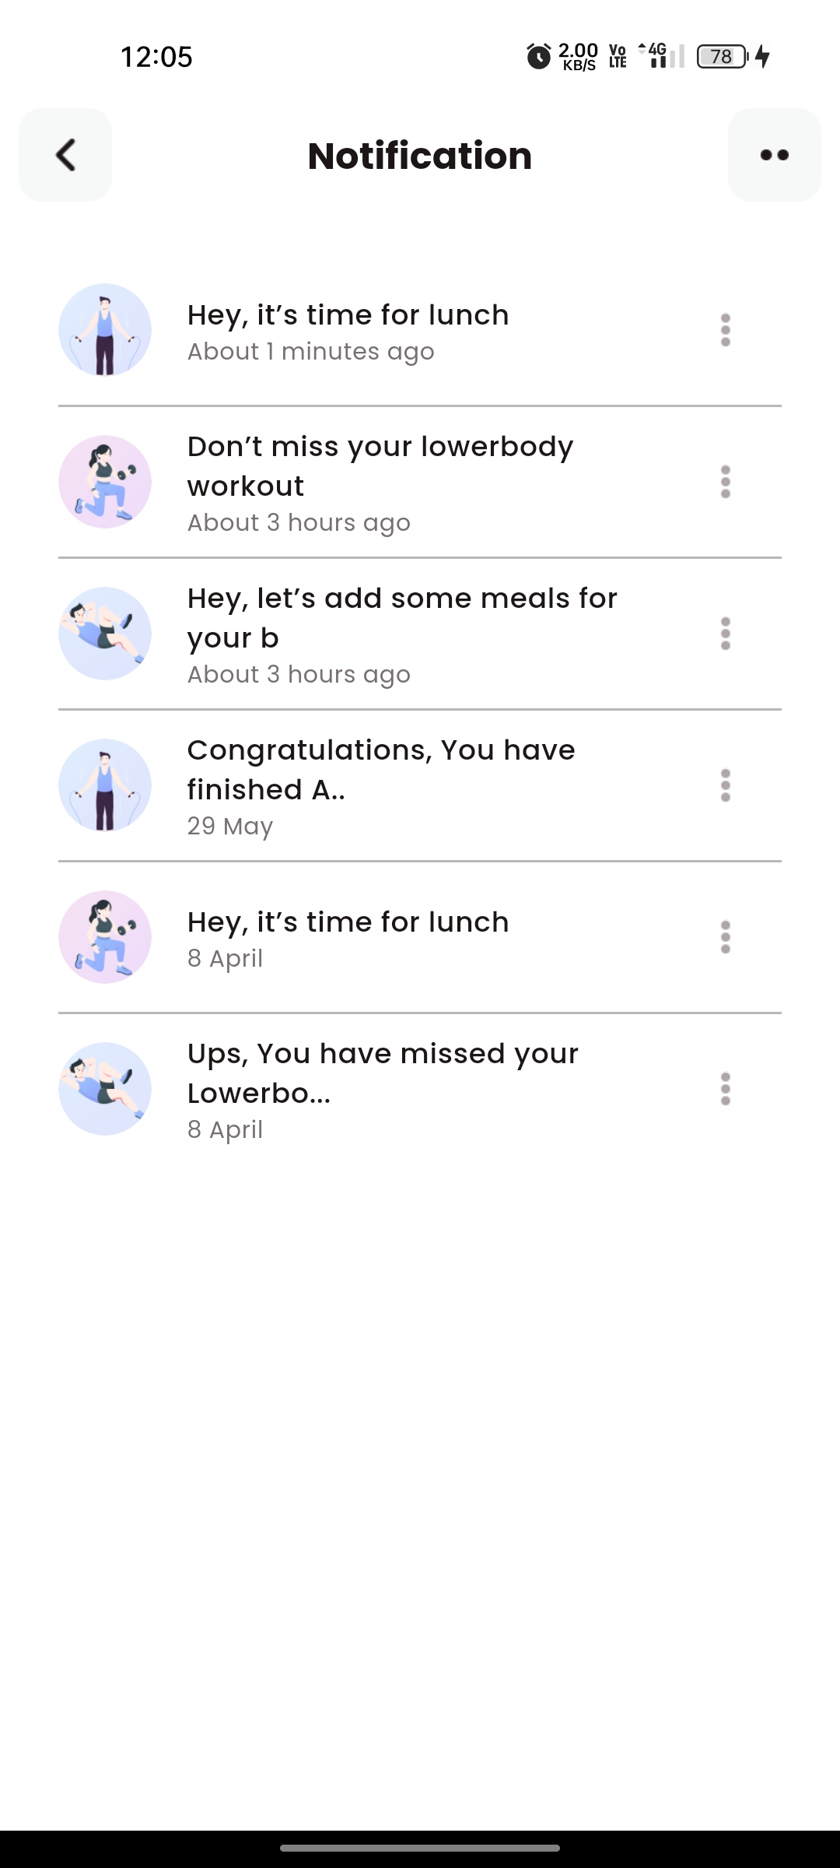
Profile and Information
06

Slide 42
TEAM 8
Project Individual Contribution
Kanishka S
Arulmurugan S
Divyesh Prasad A
2021103536
2021103510
2021103523
Frontend and Integration
Wearable Integration and Backend
Blockchain and Backend

Slide 43
Thank You
POUND TO LOSE POUND, AND GAIN POUND

